Slide 1
Generative Adversarial Networks
Presented by:
Dhaval Devshibhai Kathiriya
Sher Mohammad
Dheeraj Bharat Sethi
Instructor:
Dr. Yasser Alginahi
Nov. 3rd, 2023

Slide 2
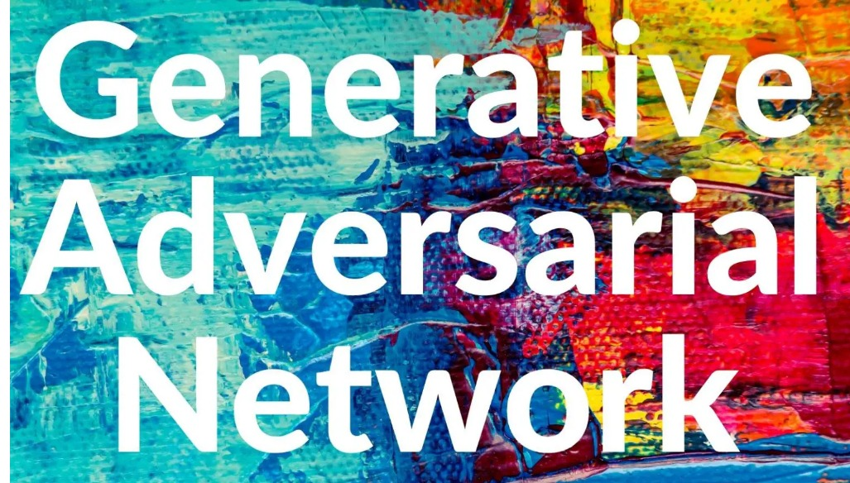
From inferring in statistics to predicting in machine learning to classifying in deep learning, AI has evolved to

Slide 3
A neural network that "generates" material the way humans produce

Slide 4
Generative 🧠
Villain 🥷 or Hero 🦸‍♀️? perspective decides
But ❤️of the GAN architecture

Slide 5
Adversarial♟️
Two Actors Competing against each other 👯‍♂️
By creating "adverse" environment

Slide 6
Networks 🧬
Actors are not humans but a Neural Network
Provides a plot for both the Generator and Discriminator
To work "against" each other towards one goal 🥅 [1].
Generate Synthetic Data

Slide 7
Generator 🎩
Responsible for "generating indistinguishable" fake data from the real data it is trained for [1]
So that it "fools" the discriminator network [1]
Improving overall performance of both networks [1]
Based on probabilistic
model

Slide 8
Discriminator🤷‍♂️🤷‍♀️
Responsible for "punishing" generator for creating fake data [2]
Catch is...only if the discriminator "catches" the fake data [2]

Slide 9
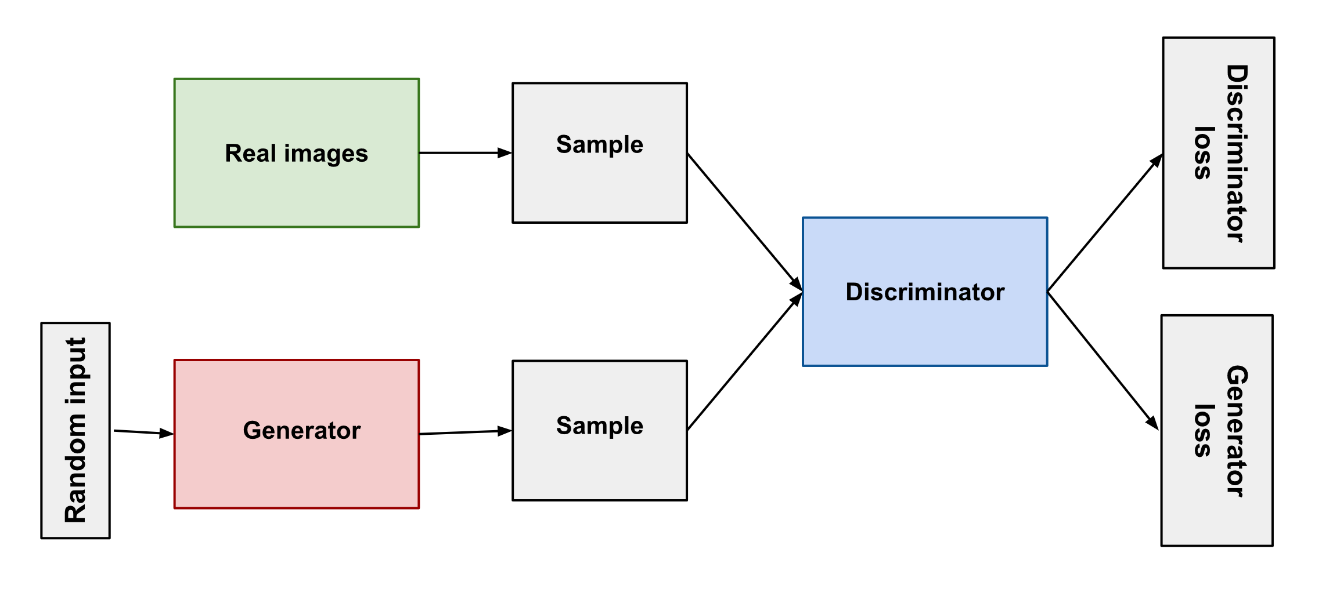
GAN Architecture 🔬
https://tinyurl.com/2nx5sy9y

Slide 10
GAN Architecture explained[3]
Initially, before training has begun, the generator’s fake output is very easy for the discriminator to recognize .
Since the output of the generator is fed directly into the discriminator as input, this means that when the discriminator classifies an output of the generator, we can apply the backpropagation algorithm through the whole system and update the generator’s weights.
Over time, the generator’s output becomes more realistic and the generator gets better at fooling the discriminator. Eventually, the generator’s outputs are so realistic, that the discriminator is unable to distinguish them from the real examples.

Slide 11
Discriminator – the real hero
Binary classifier neural network - "supervised" learning model
Takes real or generated sample as input.
Output: An array where two numbers indicate the Discriminator's estimate of probability of input example being fake or real.

Slide 12
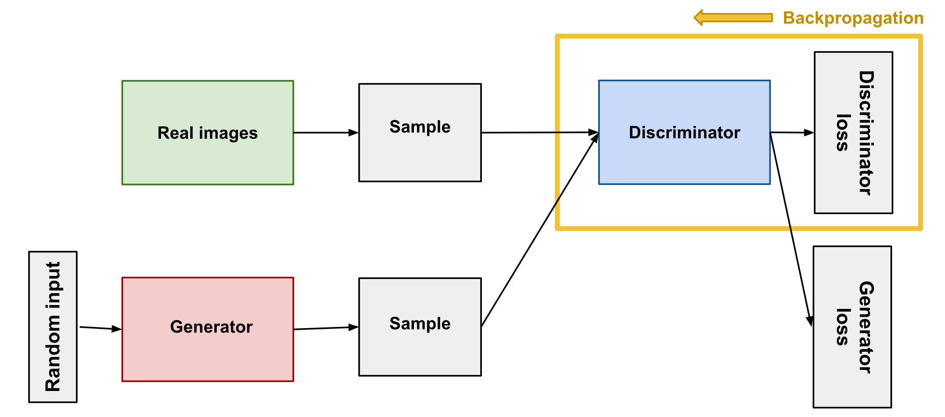
Discriminator training and learning[3]
While we are training the discriminator, we do not train the generator, but hold the generator’s weights constant and use it to produce negative examples for the discriminator.
Pass some real examples, and some fake examples from the generator, into the discriminator as input.
Calculate the discriminator loss using a suitable function such as the cross-entropy loss.
Update the discriminator’s weights through backpropagation.
Source: https://tinyurl.com/2nx5sy9y

Slide 13
GAN Code Setup and Discriminator 💻
Generative adversarial networks can also generate high-dimensional samples such as images. In this example, you’re going to use a GAN to generate images of handwritten digits. For that, you’ll train the models using the MNIST dataset of handwritten digits, which is included in the torchvision package[10].
MNIST is a dataset of 10K grayscale images of handwritten digits from 0 to 9 digits which is used in code.
Source code link: GAN-Group4-Colaboratory (google.com) [10]

Slide 14
Generator What is it & what's inside?
An "unsupervised" learning model.
This input is then passed through a series of layers, typically consisting of neural networks to transform the noise into a meaningful output.
CNN, RNN, NLP variations are developed in generative models per use-case [4].
Takes input values from random noise or latent space [4].

Slide 15
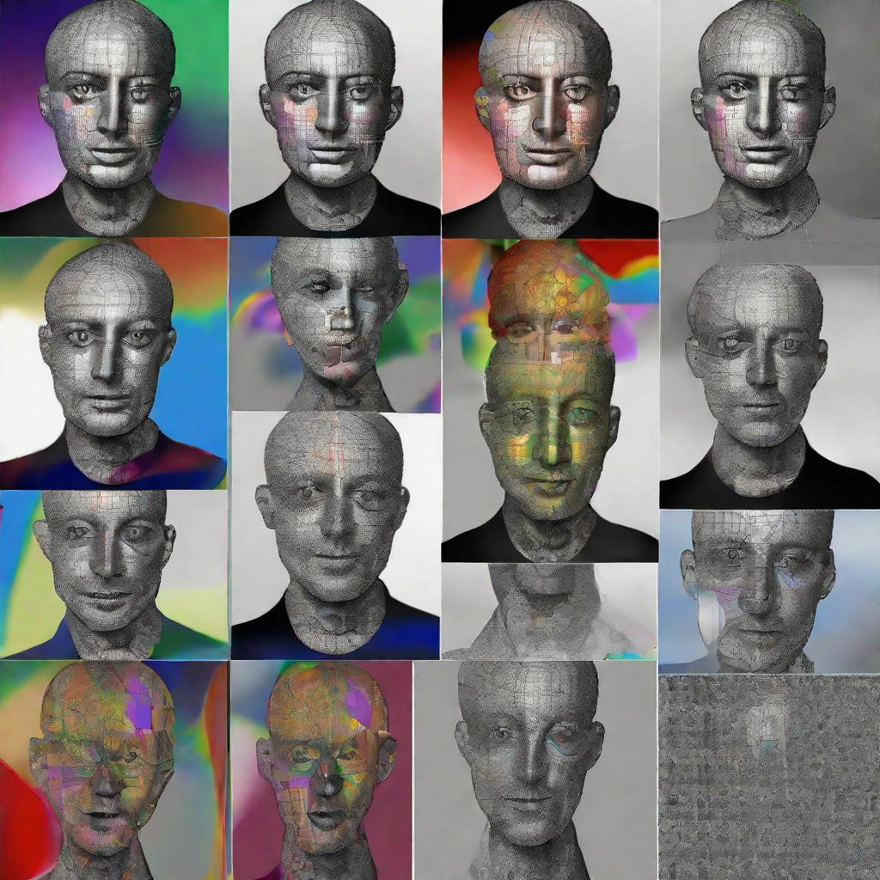
Generator training and generation
Trained to produce fake data [5].
Takes random noise as input and generates synthetic data that resemble realistic-looking data.

Slide 16
How training in Generator works
Data Understanding: Know your target data type and characteristics.
1
Input: Decide on the input (often random noise). Standard Distribution – latent space
2
Output Format: Define the output to match real data (e.g., image dimensions).
4
Activation Functions: Apply appropriate activations in networks
5
Architecture: Choose the neural network structure (e.g., CNN for images).
3

Slide 17
How training in Generator works...part 2
Regularization: Use techniques like dropout and batch normalization.
2
Optimization: Optimize the generator via adversarial training with the discriminator.
3
Hyperparameters: Experiment with settings (e.g., learning rate, architecture).
4
Quality Evaluation: Continuously assess generated quality.
5
Loss Function: Create a suitable loss function (e.g., binary cross-entropy) Z=−∑y log(ŷ) + (1−y) log(1−ŷ).
1

Slide 18
Common Activation Functions
ReLU (Rectified Linear Unit):
Sets negative input values to zero and keeps positive values unchanged.
It helps to prevent the vanishing gradient problem.
Mathematical function: f(x) = max(0, x).
LeakyReLU (Leaky Rectified Linear Unit):
An extension of ReLU that addresses the "dying ReLU" problem [6].
Prevents complete suppression of negative values.
Mathematical function: f(x) = max(αx, x), where α is a small constant.

Slide 19
Common Activation Functions cont...
Tanh (Hyperbolic Tangent):
Commonly used in the output layer of the generator.
Produce data within the range of -1 to 1.
Mathematical function: tanh(x) =(exp(x) - exp(-x))/(exp(x)+exp(-x))
Sigmoid:
Used in the output layer to generate data between 0 and 1.
Mathematical function : σ(x) = 1/(1 + exp(-x))

Slide 20
Addressing Training Instability
Causes
Oscillation and Divergence in performance
Implement regularization techniques.
Possible Solutions
Generator and Discriminator struggle to find stable equilibrium
Adjust learning rate.
Use gradient penalties.

Slide 21
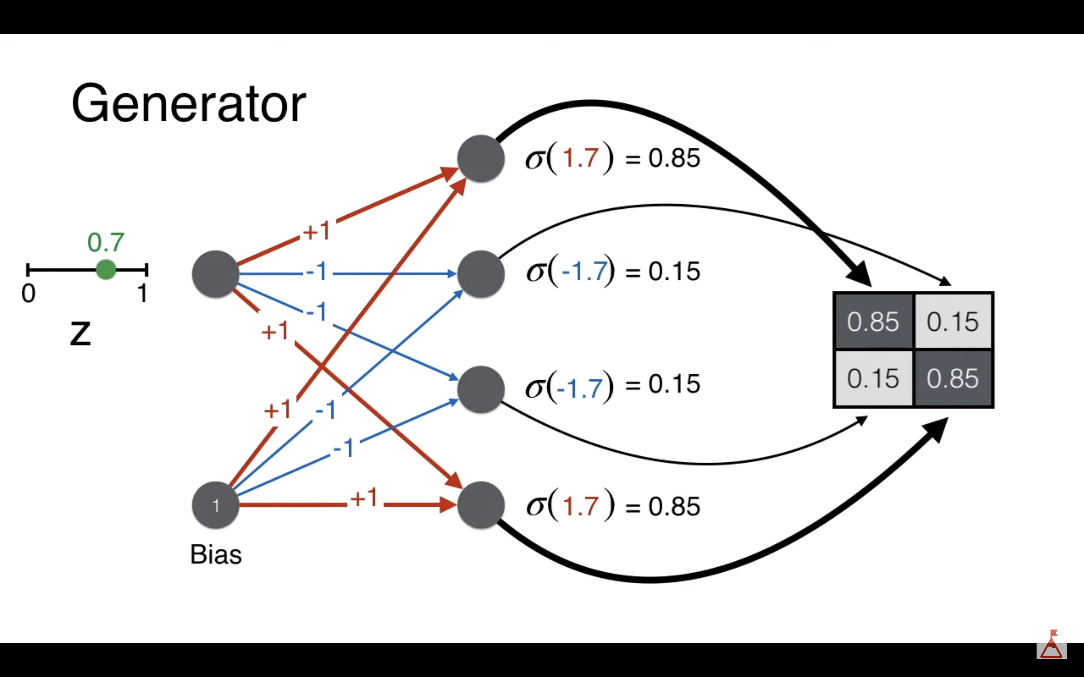
Generator Prediction Example
Weighted sum: z = w * x + b
z1=0.7*1+1=1.7 =>y = sigmoid(1.7)=0.85
z2=-0.7*1-1=-1.7 =>y = sigmoid(1.7)=0.15
z3=-0.7*1+1=-1.7 =>y = sigmoid(-1.7)=0.15
z4=0.7*1+1=1.7 =>y = sigmoid(1.7)=0.85
G(z)=(G1,G2,G3,G4)
=(σ(v1*z+b1), σ(v2*z+b2), σ(v3*z+b3), σ(v4*z+b4))
G(z)=(0.85, 0.15, 0.15, 0.85)
https://tinyurl.com/5w9zyu9y

Slide 22
GAN Code Generator 💻
GAN-Group4-Generator (google.com) [10]

Slide 23
Training GAN seems simple, right? 🥸
Let's review

Slide 24
1) Generator generates randomly first
2) Discriminator trains on real and random samples from generator
3) Discriminator provides feedback by back propagating the gradients to Generator as loss function – real vs fake
4) Generator takes feedback to regenerate new fake data
5) And this goes on until Generator is the winner...

Slide 25
In the Clash of the Networks...when️
🤺
Generator Loss
becomes less than
Discriminator Loss

Slide 26
Nash Equilibrium 🧘‍♀️
GAN achieves an equilibrium state
When the further training is stopped
Generator is ready to be used to generate fake samples
The point of Convergence
...an "optimal Discriminator" is required for it

Slide 27
What if GAN has no convergence? 🙆🏽‍♂️
Discriminator is not fixed, always fluctuating
Generator and Discriminator can't improve each other
Generator doesn't get feedbacks from its counterpart
Discriminator matures itself sooner...
Generator has found the weakness of discriminator, generating similar images once labelled as real
Due to...

Slide 28
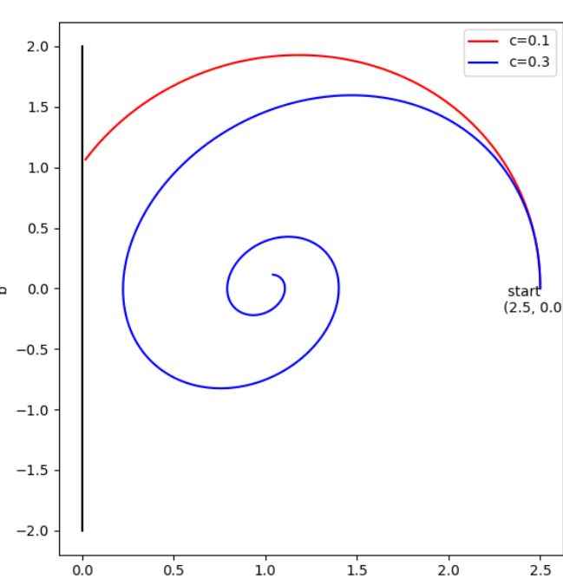
The Challenges of GAN 🪡 "research" areas
Vanishing Gradient
Mode Collapse
https://tinyurl.com/4ux9kz8z

Slide 29
Mode Collapse ^{[7]} - by a perfect discriminator
Generates few "identical" samples regardless of its inputs
Generator only learns the highest frequency among the sample space
...to induce the discriminator not to recognize generated samples
In simple words...
Generator is trying hard to fool the superb discriminator, is stuck around same "local minimum" of input

Slide 30
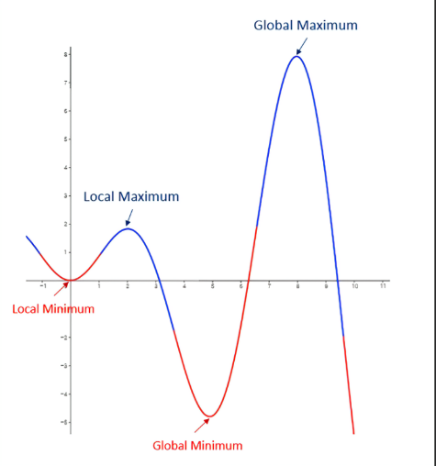
Mode Collapse – local minimum problem
Happens "later" in the training
Discriminator is perfect
Gradients for the training of the discriminator can explode
Fails to cover whole sample space
Not a fault of Discriminator, its "trapped" as well due to the same generation
https://tinyurl.com/4ux9kz8z

Slide 31
Mini batch discrimination - Regularization
Generator generates samples in mini batches
Encode the info about "uniqueness" of the batch
discriminator gets hints about how different each fake sample is from others within that batch
It acts as a regularization to incentivize coverage of the multi-modal data distribution, rather than collapsing to certain clusters

Slide 32
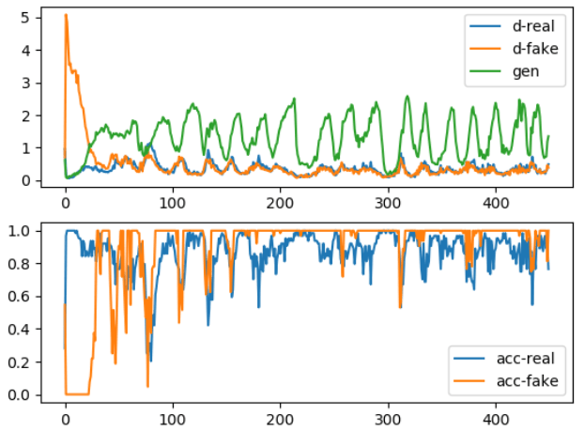
Vanishing Gradients
Occurs in "early" stages of training
When Discriminator is still learning
As it gets better, gradients to the Generator decrease
Either the updates to the discriminator are inaccurate, or they disappear.
Generator gets heavily penalized, which leads to saturation in the value post-activation function, and the eventual gradient vanishing.
https://tinyurl.com/4yx9kz8z

Slide 33
Proposed Solution – modify Discriminator's activation function
Sigmoid
Linear
Discriminator feedbacks linear "score" instead of probability to the Generator.
Discriminator is a mere "critique", not a judge

Slide 34
Evaluation Metrics [8]🎛️
Inception Score (IS):
Measures quality of generated images.
Fréchet Inception Distance (FID):
measures the similarity between two sets of images.
calculated by feeding the images into an Inception model and then measuring the distance between the distributions of the generated sets.
lower FID score --> generated images are more similar to the real images.
Calculated by feeding the generated images into an Inception model and then measuring the entropy of the model's predictions.
A higher IS score --> generated images are more realistic.

Slide 35
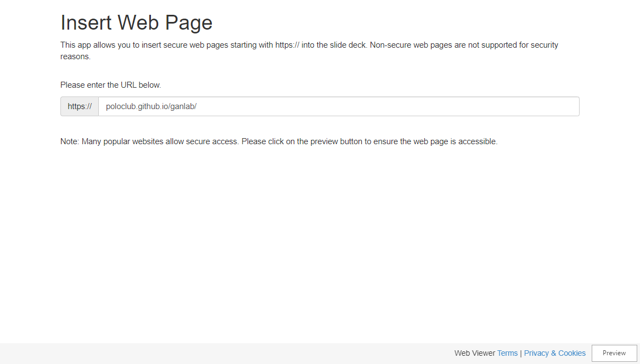

Slide 36
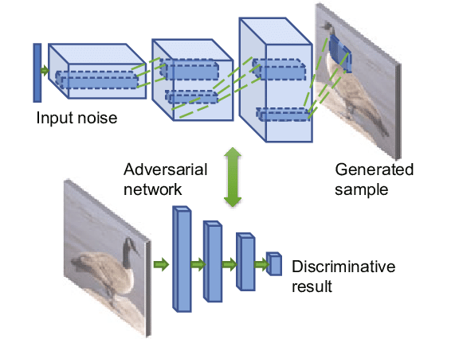
Evolution of GAN 🚀
GAN Type [9] | Description
Vanilla GAN | The original GAN architecture, consisting of a generator and discriminator network.
Conditional GAN (CGAN) | A GAN that takes in additional information, such as a label, along with the random noise vector. This additional information can be used to control the output of the generator network.
Deep Convolutional GAN (DCGAN) | A GAN that uses convolutional neural networks (CNNs) for both the generator and discriminator networks.
https://tinyurl.com/5n6db5bw

Slide 37
GAN Code Training & Loss💻
GAN-Group4-Evaluation (google.com) [10]

Slide 38
References
[1] “Generative adversarial network,” Wikipedia, Aug. 23, 2023. https://en.wikipedia.org/wiki/Generative_adversarial_network#/media/File:Generative_Adversarial_Network_illustration.svg (accessed Oct. 13, 2023).
[2] “Overview of GAN Structure | Generative Adversarial Networkttps://developers.google.com/machine-learning/gan/gan_structure
[3] T. Wood, “Generative Adversarial Network,” DeepAI, Jul. 22, 2020. https://deepai.org/machine-learning-glossary-and-terms/generative-adversarial-network
[4] R. Python, “Generative Adversarial Networks: Build Your First Models – Real Python,” realpython.com. https://realpython.com/generative-adversarial-networks/
[5] J. Hui, “GAN — What is Generative Adversarial Networks GAN?,” Medium, Dec. 26, 2019. https://jonathan-hui.medium.com/gan-whats-generative-adversarial-networks-and-its-application-f39ed278ef09
[6] P. Kishore, “Art of Generative Adversarial Networks (GAN),” Medium, Mar. 17, 2019. https://towardsdatascience.com/art-of-generative-adversarial-networks-gan-62e96a21bc35 (accessed Nov. 02, 2023).
[7] Y. Kossale, M. Airaj and A. Darouichi, "Mode Collapse in Generative Adversarial Networks: An Overview," 2022 8th International Conference on Optimization and Applications (ICOA), Genoa, Italy, 2022, pp. 1-6, doi: 10.1109/ICOA55659.2022.9934291.
[8] S. Guan and M. Loew, "Evaluation of Generative Adversarial Network Performance Based on Direct Analysis of Generated Images," 2019 IEEE Applied Imagery Pattern Recognition Workshop (AIPR), Washington, DC, USA, 2019, pp. 1-5, doi: 10.1109/AIPR47015.2019.9174595.
[9] J. Brownlee, “A Tour of Generative Adversarial Network Models,” Machine Learning Mastery, Jul. 09, 2019. https://machinelearningmastery.com/tour-of-generative-adversarial-network-models/‌
‌
‌

Slide 39
[10] R. Python, “Generative Adversarial Networks: Build Your First Models – Real Python,” realpython.com. https://realpython.com/generative-adversarial-networks/

Slide 40
Thank you🤟

